Slide 1
IOT Analytics: Design Decisions
Presented by
Edward Tanzer

Slide 2
Goals
Optimize sub-meters for real estate customers
Show ways customers may influence energy bills
Demonstrate ecological impact of smart energy management

Slide 3
Project Inception
Sub-meters are not efficiently operating
Customers high energy bills
Energy company experiencing unusually high demand

Slide 4
IOT Analytics’ Interests
Knowledge regarding sub-meter performance improvement
Insight into power usage trends
Alerts about any problematic trends

Slide 5
Current Solution Issues
No reporting has been performed
No power usage trend tracking
No sub-meter efficiency checks

Slide 6
Project Resources Requests
Real estate customer information
Regional data
Demographic data (age, education background, income, etc.)
Power company information
Existing usage solutions
Insight into resources to address customers’ needs

Slide 7
Data Resource Analysis
Current Resources
Energy usage and sub-meter setting data
December 2006 – November 2010
Over 2 million recorded observations
Storage plan
Positives
< 2% unusable records
Extremely detailed
Negatives
Data restrictions
Limited reporting ability

Slide 8
Project Distribution
Report deliverables
Data findings
Research documentation
Code

Slide 9
Data Analysis Initial Approach
Broad spectrum data analysis
Note data types and variances in values
Review data set for anomalies
Create data summary report
Address data issues
< 2% of data is unusable
On consideration of data sample size items were removed

Slide 10
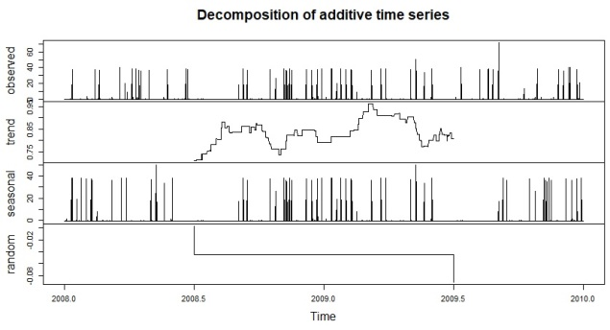
Data Analysis Process
Raw Data
Data-driven Products
Data Preprocessing
Models & Algorithms
Insights
Reports
Visual Graphs
Clean, Structured Data
Exploratory Data Analysis (EDA)

Slide 11
Potential Pitfalls
Possible issues
Exploratory Data Analysis (EDA)
Unexpected insights
Lack of trending data
Lack of correlation
Solution: Possible change of strategy and project outlook

Slide 12
Data Insights
Trend of power usage spikes
Highest average voltage should be 220 volts
Mean Average Voltage Readings
 | Year | Voltage
 | Year 1 | 239.4
 | Year 2 | 240.6
 | Year 3 | 241.8
 | Year 4 | 241.7
 | All Data | 240.8

Slide 13
Data Insights
Possible cases of power outages
Possible electronic device failure
Mean Average Global Reactive Power
 | Year | Voltage
 | Year 1 | 0.12
 | Year 2 | 0.12
 | Year 3 | 0.13
 | Year 4 | 0.13
 | All Data | 0.12

Slide 14
Outro

Slide 15
Citations
Data analysis process outline
4 Reasons Why Data Analytics is Important. Sanon, Malika. 2017. http://www.digitalvidya.com/blog/reasons-data-analytics-important/

